Slide 1
Asynchronous JavaScript or How to avoid Callback Hell

Slide 2

Mihails Semjonovs
Currently working in “Accenture” as JS/Node developer
Overall work experience more than 9 years
Experienced in both: front and back-end

Slide 3


What is Callback ?

Slide 4
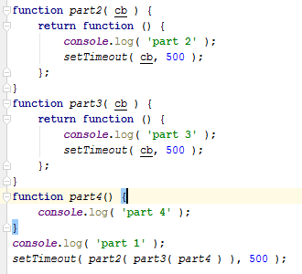
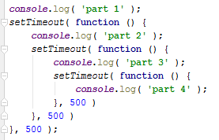
What is callback hell ?

Slide 5

Callback hell example

Slide 6
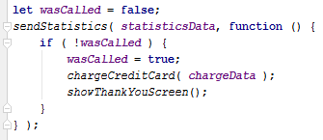
Callback hell example

Slide 7
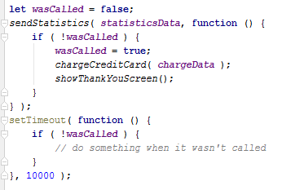
Callback hell example

Slide 8
2 Major Callback Problems:
Inversion of control ( lack of it )
Mind is not designed
We can’t trust resources as they could call our callback wrong:
Too early
Too late
Multiple times
Not a single time
Context could be lost
Errors could be lost
…
We need to switch to different parts of our code to find how it works
We have to remember what’s happened before
Our brain would make a map of all callbacks and place them in synchronous fashion in order for us to understand them

Slide 9
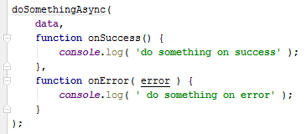
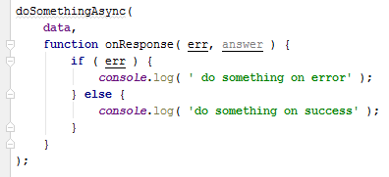
Callback hell non fixes
Multiple callbacks – one for response one for error
Error first ( node style ) error callbacks

Slide 10
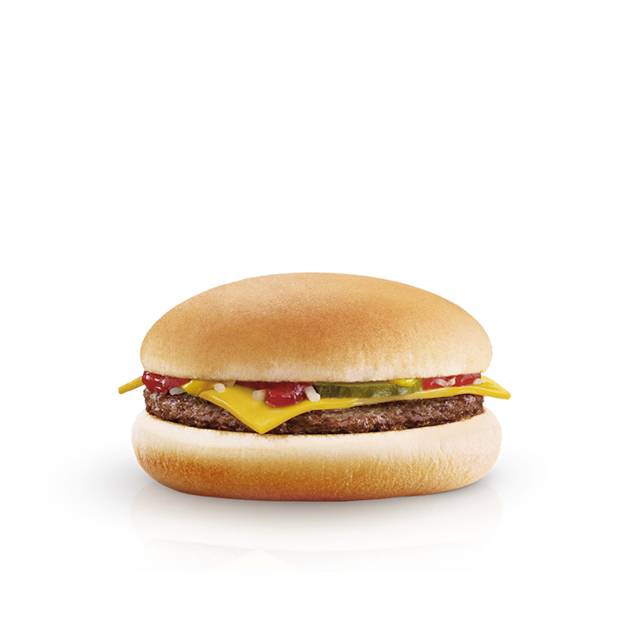
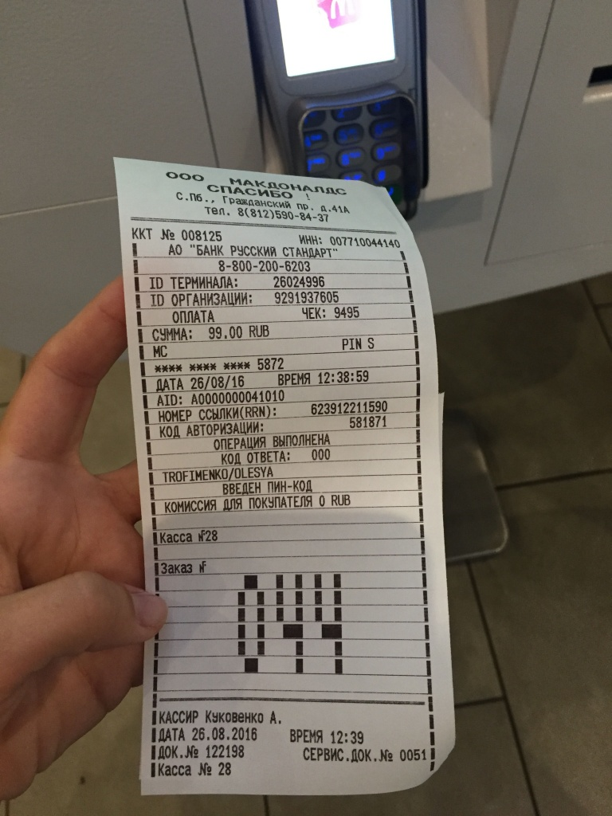
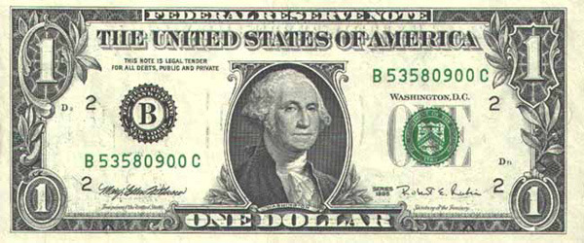
What is Promise ?
Utility
Promise
Value

Slide 11
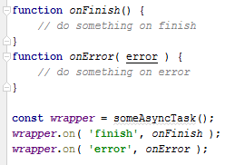
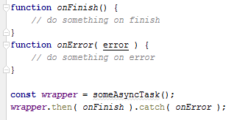
What is Promise ?

Slide 12
Promises Trust
Only resolved once
Either success or error
Messages passed/kept
Exceptions becomes errors
Immutable once resolved

Slide 13
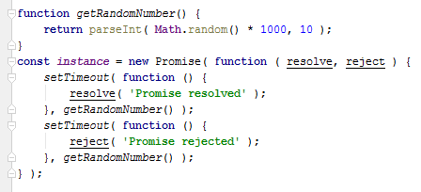
Promises api

Slide 14
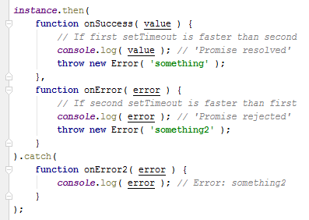
Promises api

Slide 15

Promises api

Slide 16
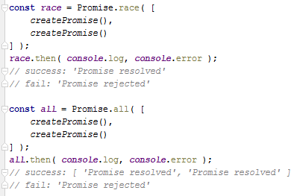
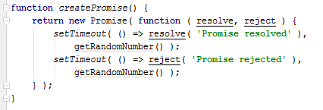
Promises api

Slide 17
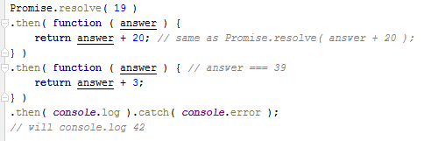
Promise api
Bluebird
Asynquence

Slide 18
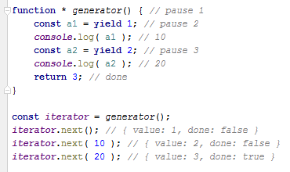
What is generator ?

Slide 19
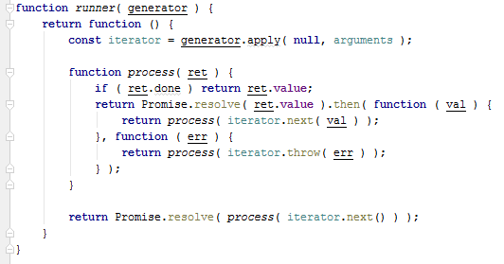
Generator run function

Slide 20
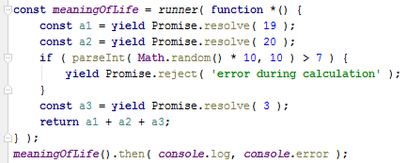
Generator example

Slide 21
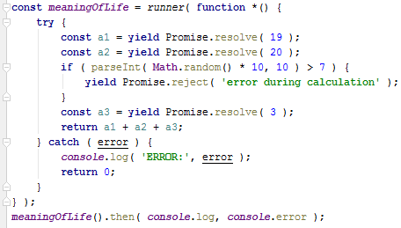
Generator example

Slide 22
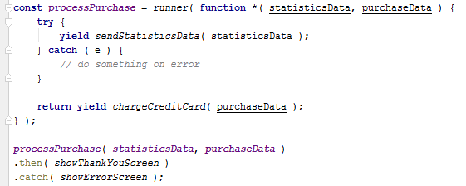
Generator example

Slide 23
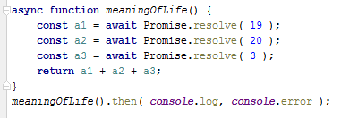
Async/await

Slide 24
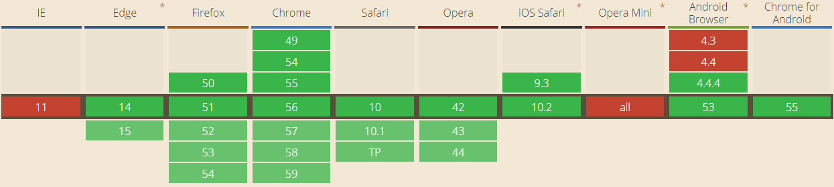
Compatibility of Promise
12
29
33
7.1
20
8
Jul 29 2015
Feb – Mar 2014
Sep 2014

Slide 25
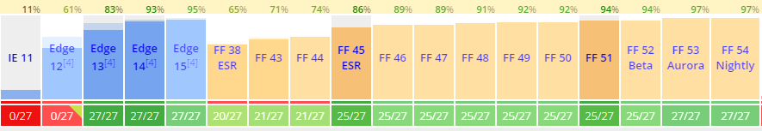
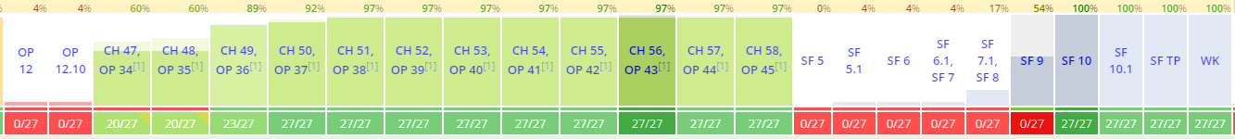
Compatibility of Generators
Nov 2015
Apr – May 2016
Babel

Slide 26
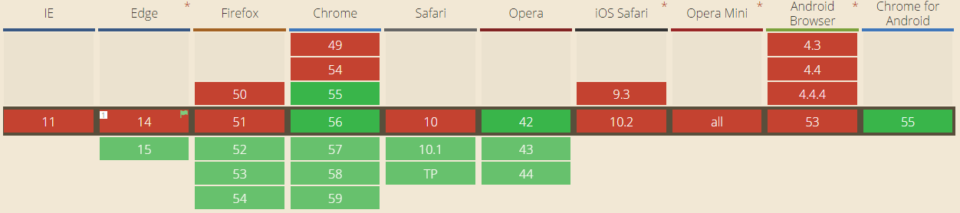
Compatibility of async/await
Dec 2016

Slide 27
Untold solutions
Thunks
Rx.Observable
Communicating Sequential Processes pattern
Native Observables ( future )
Async generators ( future )

Slide 28
Questions ?

Slide 29
Thanks!

